Slide 1
Watershed Restoration, Chesapeake Bay
Nutrients and Sediment: The Chesapeake Bay TMDL Process
Paul D. Capel (capel001@umn.edu)
University of Minnesota
Department of Civil, Environmental, and Geo- Engineering
U.S. Geological Survey
National Water Quality Assessment Program
Gary W. Shenk (GShenk@chesapeakebay.net)
U.S. Geological Survey
Chesapeake Bay Program
Photographs from: Chesapeake Bay Program Archive

Slide 2
Comparison of Minnesota and the Chesapeake Bay Watershed
 | Chesapeake Bay Watershed | Minnesota
Area (miles²) | 64,000 | 87,000
Population (2010) | 17,300,000 | 5,300,000
% Developed | 11 | 3
% Agricultural | 24 | 54
% Undeveloped | 64 | 43
NY, PA, MD, DE, WV, VA, and DC

Slide 3
Differences in Minnesota and Chesapeake Bay Watershed
Land of Chesapeake Bay Land of 10,000 Lakes
(and a Few Reservoirs)
- Receiving waters
- Lakes
- Wetlands

Slide 4
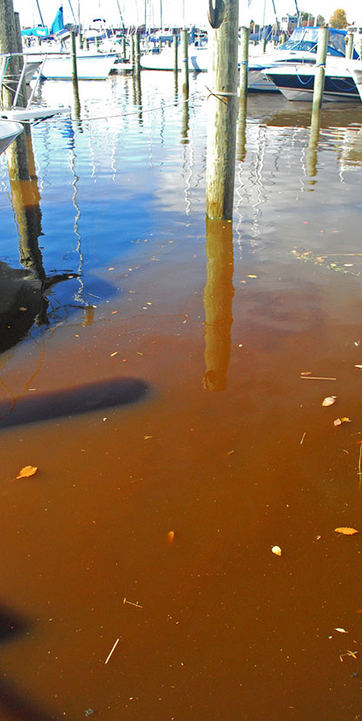
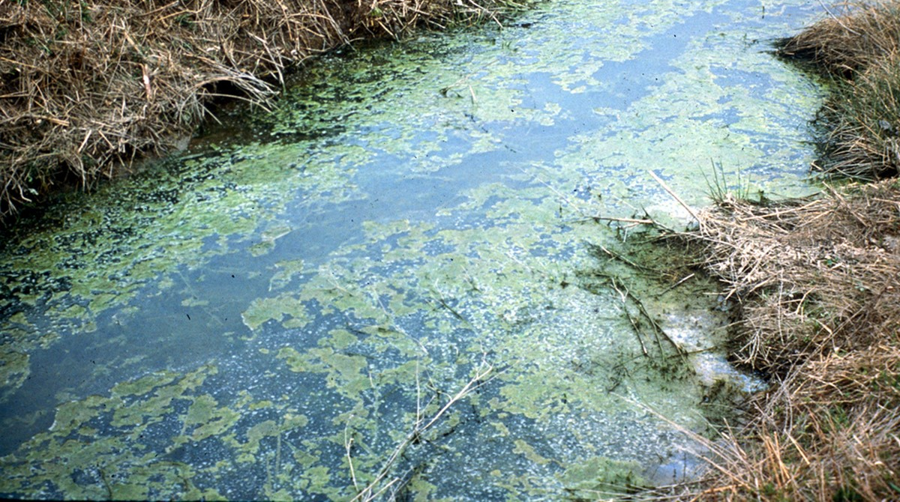
Less of this…
Less of This

Slide 5
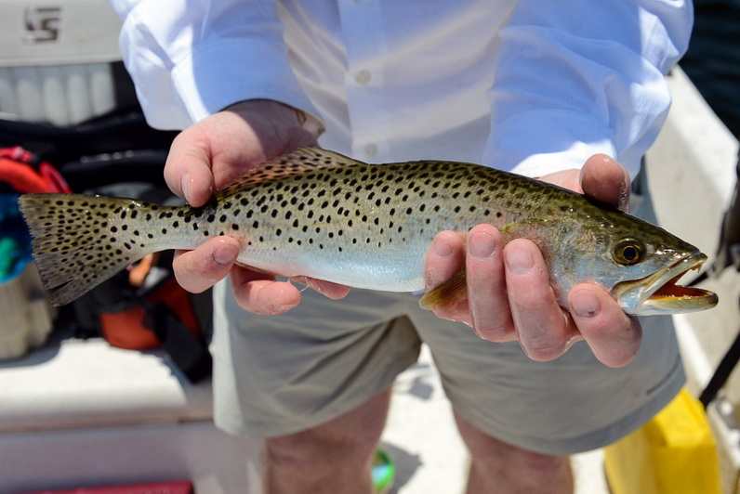
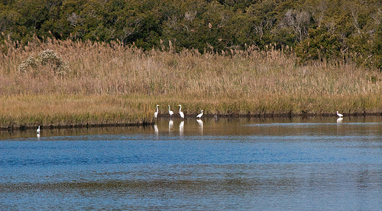
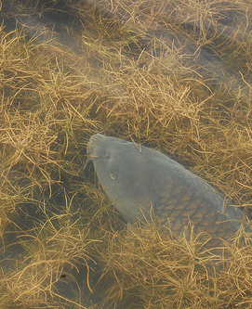
More of this…
More of This

Slide 6
Chesapeake Bay Watershed TMDL for Nutrients and Sediment
Timeline
1999 – Lawsuit by American Canoe Association
and American Littoral Society
2010 – TMDL put in place
Reduction in annual loads to Chesapeake Bay:
25% for N, 24% for P, 20% for Sediment
2017 – Mid-Point Assessment
  60% of the management practices implemented
2025 – TMDL Goal Date
  100% of the management practices implemented
  Minnesota Clean Water, Land and Legacy Amendment: 2008 → 2034

Slide 7
Chesapeake Bay Watershed TMDL Stakeholders
Federal agencies
  Environmental Protection Agency (EPA)
  US Department of Agriculture (USDA)
  US Forest Service (USFS)
  US Geological Survey (USGS)
  US Fish and Wildlife Service (USFWS)
  And more
State agencies
  Natural Resources/Environmental departments
  Agricultural departments
  Parks and Recreation groups
  Fish and Wildlife agencies
Local Governments
Non-profit organizations
  Chesapeake Bay Foundation
  Center for Watershed Protection
  Ducks Unlimited
  National Fish and Wildlife Foundation
  And more
Academic institutions
  Land grant universities
  Cooperative Extension programs
  Sea Grant programs
  Research centers and consortiums
  And more
Chesapeake Bay Program
www.chesapeakebay.net

Slide 8
1
Chesapeake Bay TMDL Philosophy for Planning
Areas that contribute the most to the problem must do the most to resolve the problem.
All reductions in loads are credited toward achieving final assigned loads.
Sum of allocated loads must result in attainment of water quality standards
Urban BMPs
Ag BMPs
Effort
WWTPs
Effectiveness
Notes:
8

Slide 9
2
Goals Established by
State and Watershed
Basin allocations for Nitrogen and Phosphorus
(Million pounds per year)

Slide 10
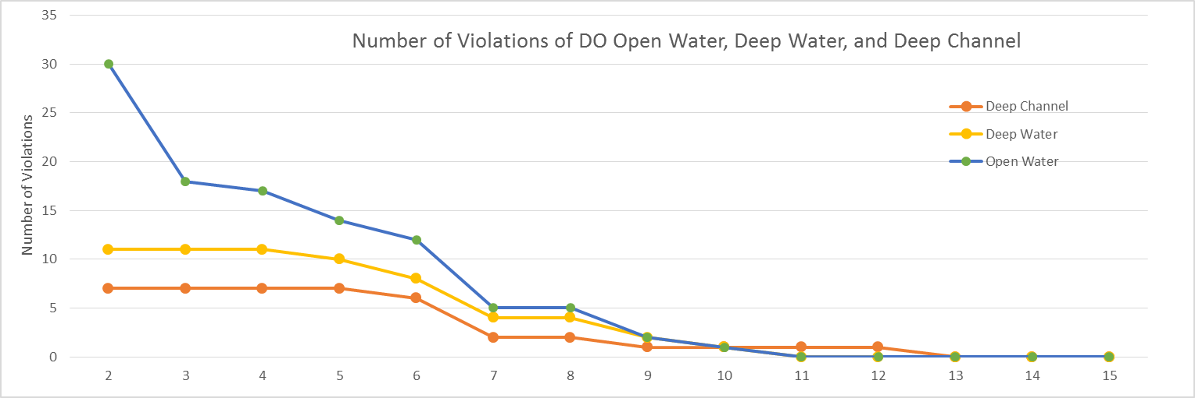
3
Track Progress toward TMDL Goals
Allocated loads must result in achievement of the Bay water quality standards
Fewer Violations
Reduced Loads

Slide 11
4
Planning and Tracking Progress accomplished through Models
CB: large-scale (Phase 6) small-scale (CAST)
MN: large-scale (HSPF-SAM) small-scale (N-BMP, P-BMP, PTMApp)

Slide 12

Optimization engine
4
Planning and Tracking Progress accomplished through Models
Best Management Practices (BMPs)
Less nutrients
Less sediment
Modeling
Tools
Optimization engine
Minimize
Total Cost ($)
Achieve target
Load Reduction

Slide 13
Implementation of BMPs for Reduction of Nitrogen, 1985-2014
Agricultural BMPs Urban BMPs
Sekellick, A.J., Devereux, O.H., Keisman, J.L.D., Sweeney, J.S., and Blomquist, J.D., 2019, Spatial and temporal patterns of Best Management Practice implementation in the Chesapeake Bay watershed, 1985–2014: U.S. Geological Survey Scientific Investigations Report 2018–5171, 25 p., https://doi.org/10.3133/sir20185171.

Slide 14

Nitrogen Conceptual Model
fertilizer & manure
land
BMPs
Rivers
To Bay
water
water
groundwater
The watershed is conceptualized as a series of filters.

Slide 15

Phosphorus and Sediment Conceptual Models
For phosphorus and sediment, storage is important.
Storage
Phosphorus
channels, other
Fertilizer & manure
land
BMPs
water
BMPs
Reservoirs
water
water
water
To Bay
Sediment
Storage
channels, other
land
BMPs
water
BMPs
Reservoirs
water
water
water
To Bay

Slide 16
Every location on the landscape is connected to a stream
… either directly or indirectly via groundwater and lakes

Slide 17
1. All parts of the landscape do not contribute N, P, and sediment equally.
land
Critical Contributing Areas

Slide 18
2. Groundwater contributions of water and nitrogen to
streams (and lakes) can be very important and delayed.

Slide 19
Looking forward and back …
Nitrogen in the Chesapeake Watershed:
A Century of Change, 1950-2050

Slide 20
Looking forward and back … MN WQ Model to 2034 and beyond
Putting past and future into context from our present understanding
→ Current WQ is the result of past activities
→ Future WQ will be the result of the current conditions and
future decisions / activities.
→ Help quantify what has be done to improve / maintain WQ.
→ Provide decision making tool (“what if” scenarios).
In 2034 with a forecasting model, can we should be able to say …
→ How WQ has improved in __ Lake or __ River
due to the Legacy Amendment efforts. (Improvement)
→ What the WQ would have been in __ Lake or __ River,
if Legacy Amendment efforts were not done. (Protection)

Slide 21
Summary
1. Chesapeake Bay established a TMDL philosophy for planning purposes.
Areas that contribute the most to the problem must do the most to resolve the problem.
2. N, P, and sediment goals were established by state and watershed.
3. Progress was tracked toward the TMDL goals (BMP implementations, …).
4. Planning and tracking progress was accomplished through models
(with iteration for optimization)
Every location on the landscape is connected to a stream
… either directly or indirectly via groundwater and lakes.
→ All parts of the landscape do not contribute N, P, and sediment equally.
→ Groundwater contributions of water and nitrogen to streams (and lakes)
can be very important and delayed.
There may be value in using MN models to forecast WQ protection/improvements.

